Slide 1
Process Kinetics

Slide 2
Important Process and their Kinetics
Enzyme kinetics
Fermentation kinetics

Slide 3
Microbial Cell Growth
Microbial growth implies an increase in cellular constituents
- leads to rise in cell number when microorganisms
reproduce by processes like budding or binary fission
- ability to reproduce is a major criterion to determine if
a microbe is alive or not
- results when cell become longer/larger
Population growth is used to analyze the growth curve of a
microbial culture

Slide 4
Microbial Cell Growth
Mode of Growth
Selective assimilation of nutrients and convert into and also include Chemical rearrangement of protoplasmic material characteristic of the particular organism
Production of an increased amount of nuclear substance and cell division

Slide 5
Microbial growth summary
Energy + nutrient ⇒ biomass and products
Energy (light or chemical): phototrophs and chemotrophs
Nutrient (carbon source): autotroph and heterotroph

Slide 6
Stoichiometry of growth
Carbon + Nitrogen + (P&vitamins&minerals) + O₂ → biomass + CO₂ + H₂O + products + heat
αCH_{l}O_{m} + βNH₃ + γO₂ → CH_{a}O_{b}N_{c} + δCH_{p}O_{q}N_{r} + εH₂O + κCO₂
CH_{l}O_{m} : element composition of the carbon sources
CH_{a}O_{b}N_{c:} element composition of biological materials
CH_{p}O_{q}N_{r} element composition of extracellular products
(All defined as containing 1 gram atom of carbon)

Slide 7
Atomic balance
αCH_{l}O_{m} + βNH₃ + γO₂ → CH_{a}O_{b}N_{c} + δCH_{p}O_{q}N_{r} + εH₂O + κCO₂
C: α=1+ δ+ κ
H: lα + 3β = a +1+ pδ+ 2ε
O: mα + 2γ = b + β + qδ + ε + 2κ
N: β = c + rδ

Slide 8
Respiratory coefficient and degree of reductance
Respiratory quotient or coefficient (RQ)
RQ = rate of CO₂ production/rate of O₂ consumption
Degree of reductance (γ): the number of equivalents of available electrons per gram atom of C.
C:4,. H:1, O: -2, N: -3: P:5
γ_{H2O,} γ_{CO2}, γ_{NH3}=0, γ_{glucose} = 24.

Slide 9
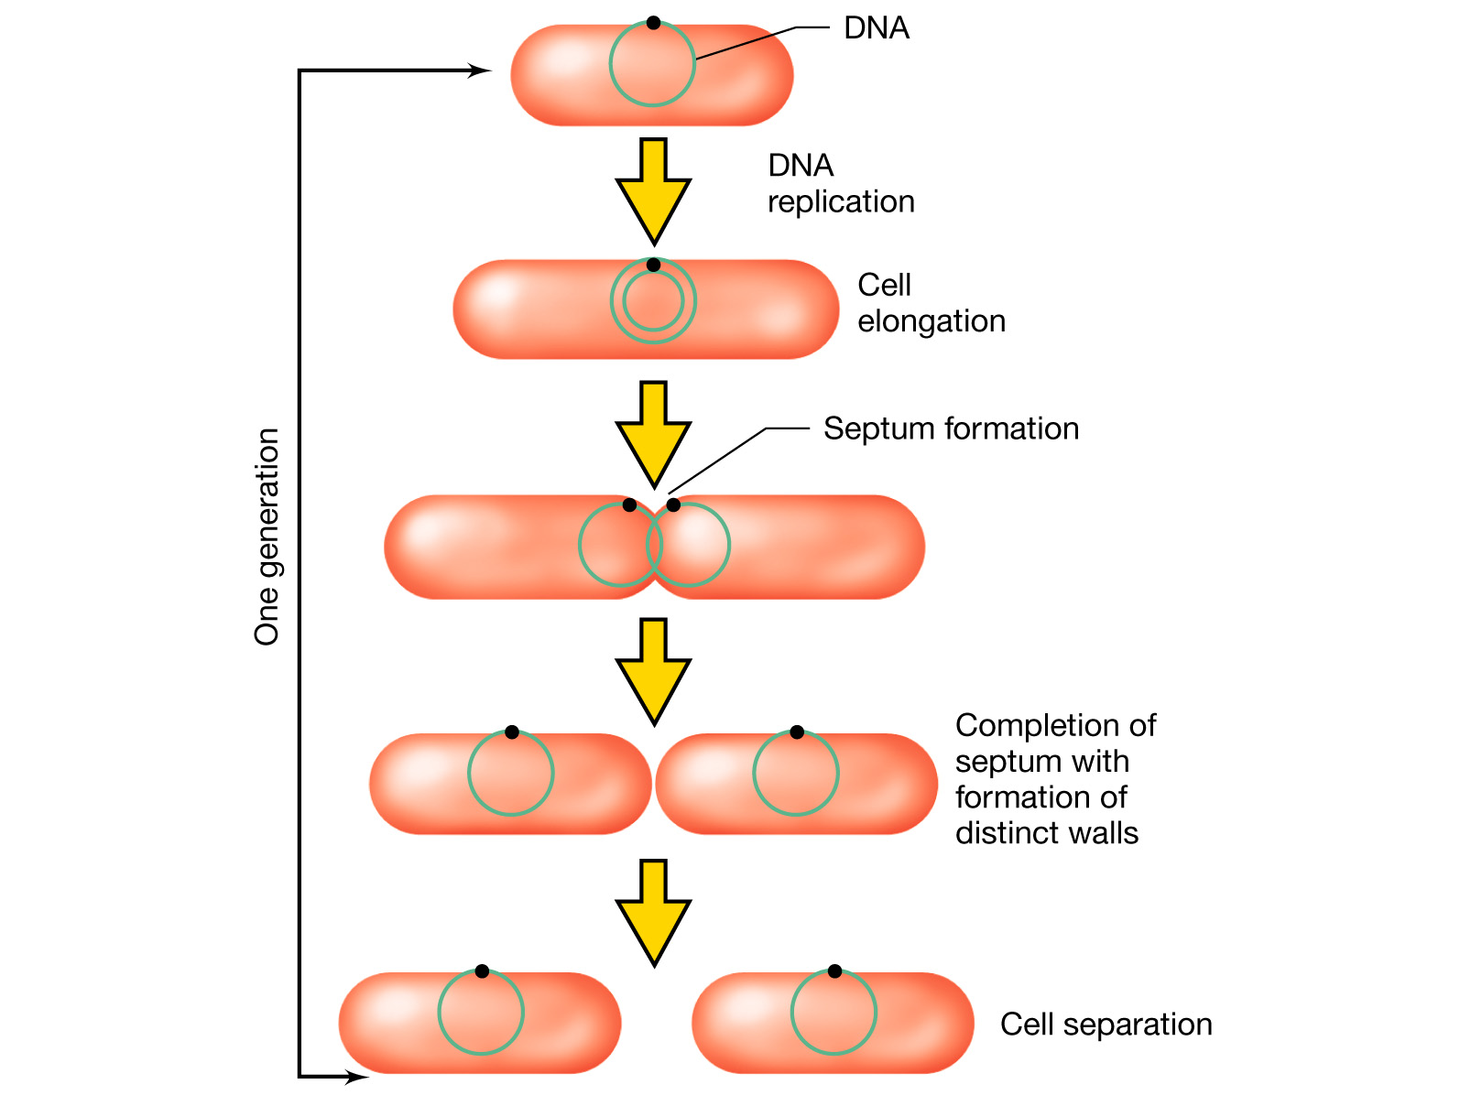
Cell Growth and Binary Fission
Fts proteins
forms in the
space between
the duplicated
nucleoids
Min E proteins assist
in the location of the
actual cell midpoint

Slide 10
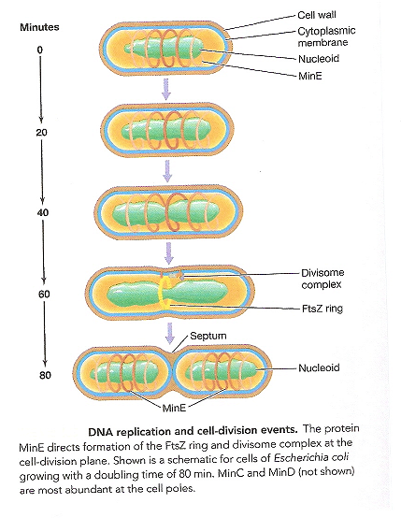

Slide 11
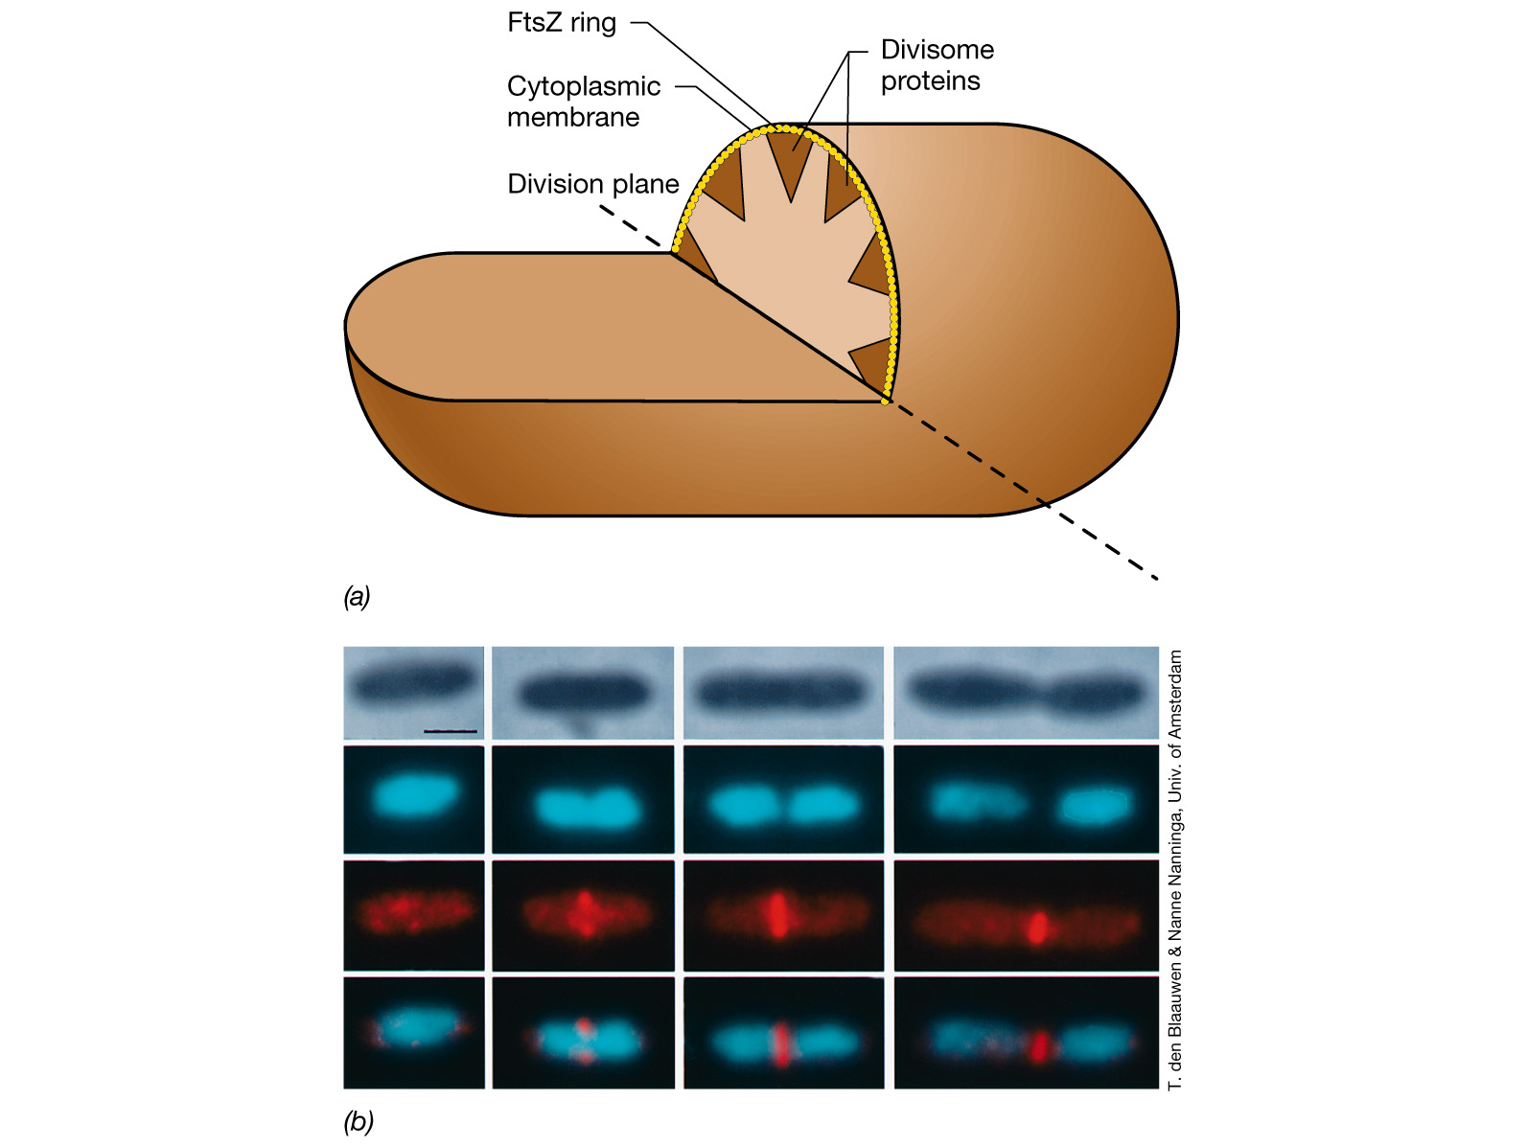
forms a ring around
the cylinder in the
center of the cell
The FtsZ ring
and cell division

Slide 12
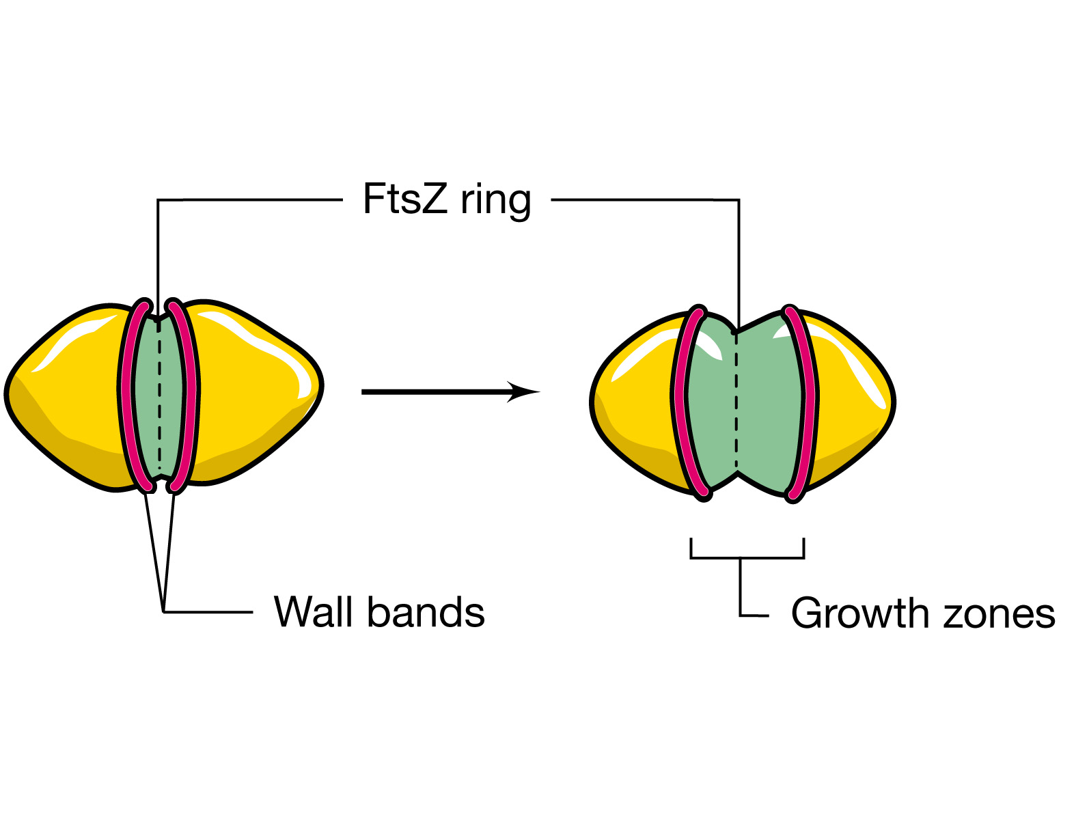
2 copies of chromosomes
are pulled apart to each
daughter cell

Slide 13
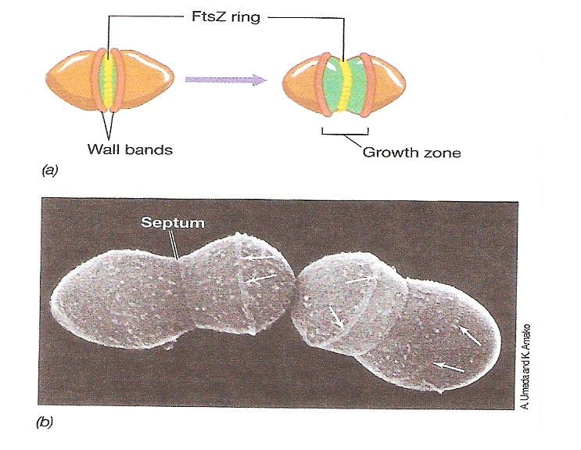

Slide 14
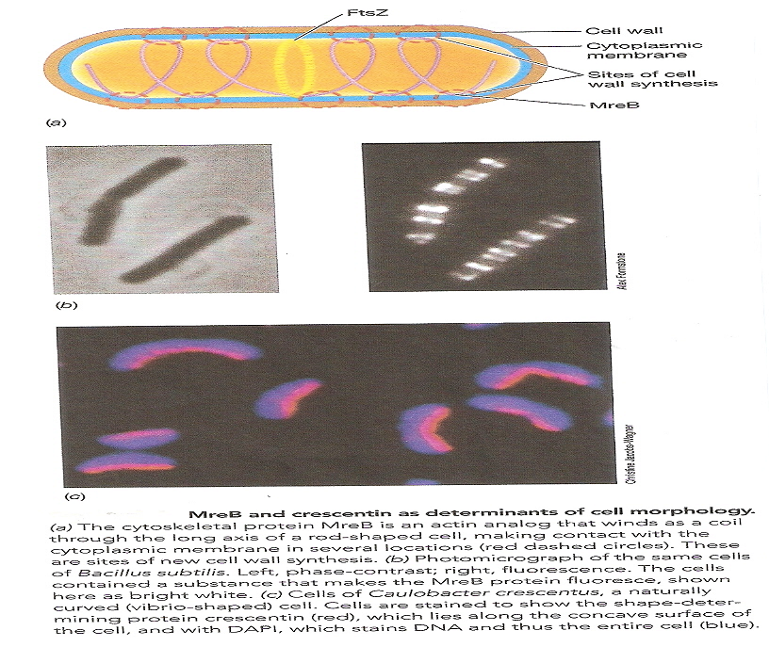

Slide 15
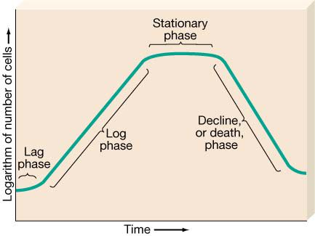
Microbial Growth Kinetics
- describe how the microbe grows in the fermenter
- important to determine optimal batch times
growth of microbes can be broken down into 4 stages;
LAG PHASE
LOG/EXPONENTIAL PHASE
STATIONARY PHASE
DEATH PHASE
accelerated
death phase
decelerated
growth phase
Lag Phase
Cells have just been introduced into a new environment
Cell growth is minimal
Cell is synthesizing new components – no cell division takes place
accelerated growth phase
cell is old and depleted of ATP
medium may be different from the one the microorganism was growing
microorganism have been injured and require time to recover

Slide 16
LOG/EXPONENTIAL PHASE
Cells have adjusted to their environment
Rapid growth takes place
Cell growth rate is highest in this phase
At some point, cells growth rate level off
and become constant
STATIONARY PHASE
Cell growth rate has leveled off and become constant
Number of cells multiplying equals the number of cells dying
- nutrient limitation
- aerobic organism are limited by oxygen availability
- population growth cease due to the accumulation of toxic
waste products
DEATH PHASE
Decline in the number of viable cells

Slide 17
Log/Exponential Phase
The rate of increase in biomass is correlated with the specific
Growth rate µ and the biomass concentration X (g/L), whereas the
Rate of sincrease in cell number is correlated with µ and cell density N (1/L)
d X = µ • X or d N = µ • N
d t d t
specific growth rate, µ,
3 parameters : the concentration of limiting substrate S
the maximum growth rate µ_{mv}
the substrate-specific constant _{Ks}
µ = µ_{m} ___S___
K_{s} + S
Monod equation
K_{s} substrate concentration at which half
the maximum specific growth rate is
obtained (µ = 0.5 µm )
- equivalent to the Michaelis constant in enzyme
kinetics

Slide 18
Growth Approximation
X [g/l]
μ_{m}
μ_{m}
1.0
t
X
m
μ
X
i
t [h]

Slide 19
Approaches to modeling cell growth:
Unstructured Models
(cell population is treated as single component)
Structured Models
(cell population is treated as a multi-component system)
Nonsegregated Models
(cells are treated as homogeneous)
Segregated Models
(cells are treated heterogeneous)

Slide 20
Approaches to modeling cell growth:
Unstructured Nonsegregated Models
(cell population is treated as single component, and cells are treated as homogeneous)
Structured Segregated Models
(cell population is treated as a multi-component system, and cells are treated heterogeneous)
Most realistic, but are computationally complex.
Simple and applicable to many situations.

Slide 21
Unstructured, nonsegregated models:
Monod model:
μ_{m} C_{S}
Most commonly used model for cell growth
μ =
K_{S} + C_{S}
μ : specific (cell) growth rate
μ_{m} : maximum specific growth rate at saturating substrate concentrations
C_{S} : substrate concentration
K_{S} : saturation constant (C_{S} = K_{S} when μ = μ_{m} / 2)

Slide 22
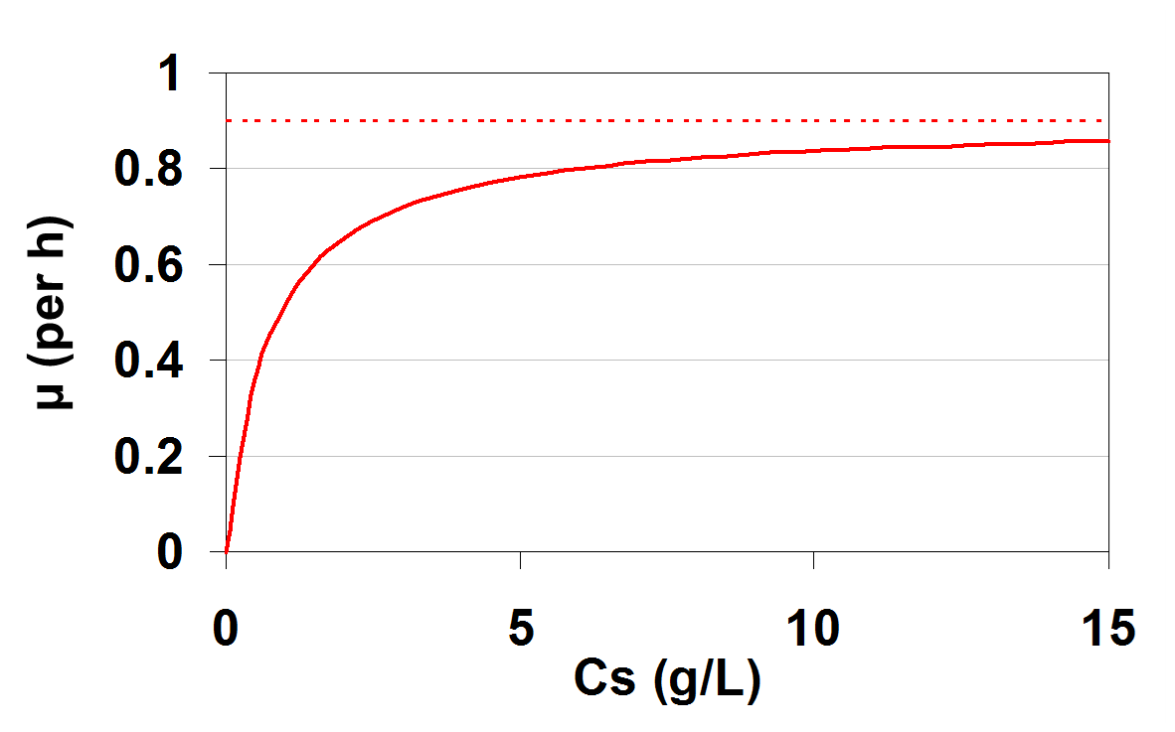
Unstructured, nonsegregated models:
Monod model:
μ_{m} C_{S}
Most commonly used model for cell growth
μ =
K_{S} + C_{S}
μ_{m} = 0.9 per h
Ks = 0.7 g/L

Slide 23
Assumptions behind Monod model:
- One limiting substrate
Semi-empirical relationship
Single enzyme system with M-M kinetics being responsible for the uptake of substrate
Amount of enzyme is sufficiently low to be growth limiting
Cell growth is slow
Cell population density is low

Slide 24
Other unstructured, nonsegregated models (assuming one limiting substrate):
Blackman equation:
μ = μ_{m} if C_{S} ≥ 2K_{S}
μ_{m} C_{S}
μ =
if C_{S} < 2K_{S}
2 K_{S}
Tessier equation:
μ = μ_{m} [1 - exp(-KC_{S})]
μ_{m} C_{S}^{n}
Moser equation:
μ =
K_{S} + C_{S}^{n}
μ_{m} C_{S}
Contois equation:
μ =
K_{SX} C_{X} + C_{S}

Slide 25
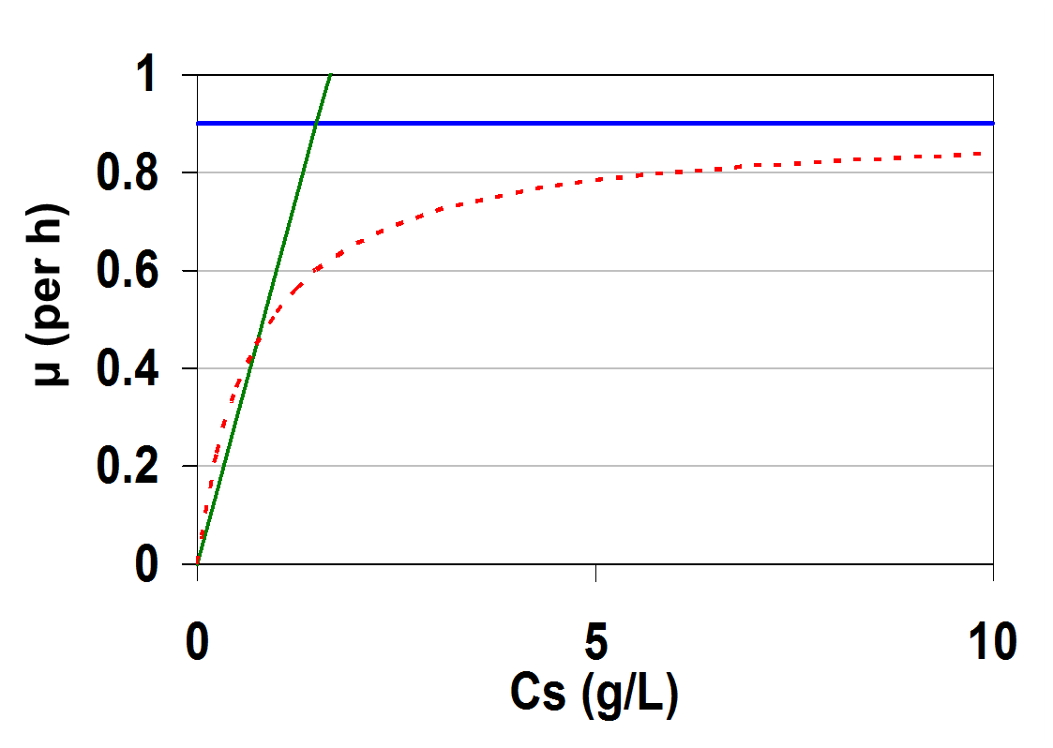
Blackman equation:
μ = μ_{m}
if C_{S} ≥ 2 K_{S}
This often fits the data better than the Monod model, but the discontinuity can be a problem.
μ_{m} C_{S}
μ =
if C_{S} < 2 K_{S}
2 K_{S}
μ_{m} = 0.9 per h
Ks = 0.7 g/L

Slide 26
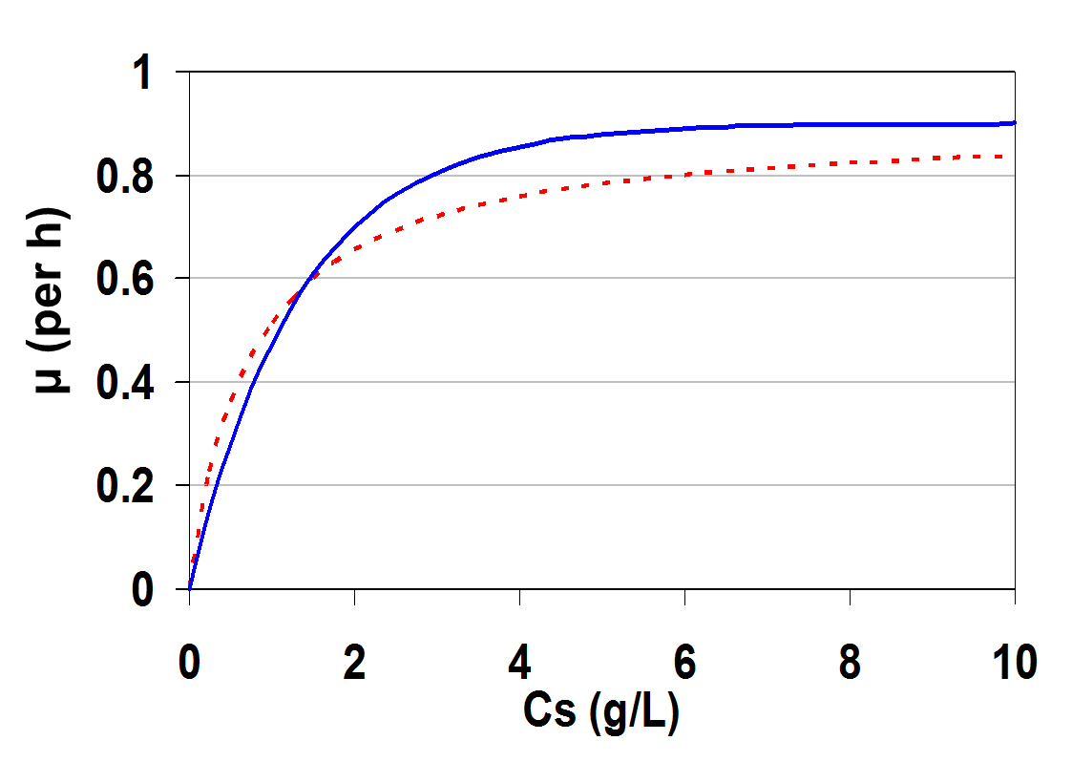
Tessier equation:
μ = μ_{m} [1 - exp(-KC_{S})]
μ_{m} = 0.9 per h
K = 0.7 g/L

Slide 27
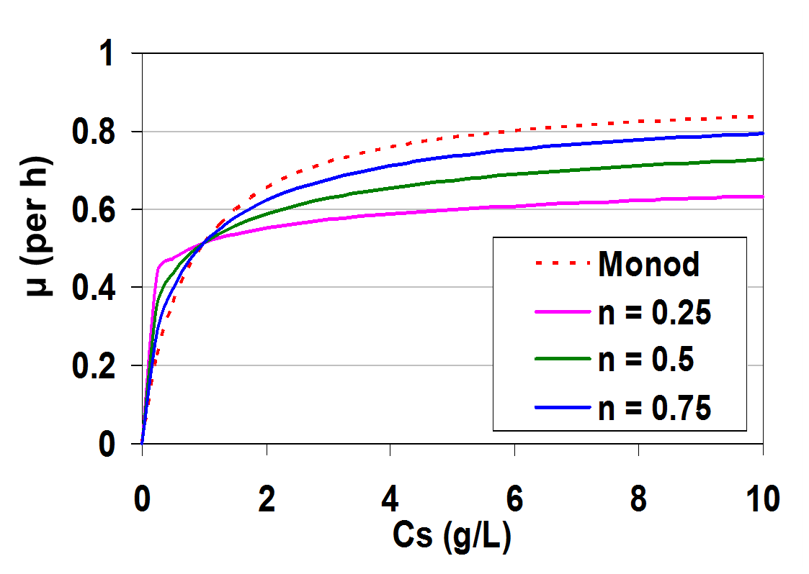
Moser equation:
μ_{m} C_{S}^{n}
μ =
When n = 1, Moser equation describes Monod model.
K_{S} + C_{S}^{n}
μ_{m} = 0.9 per h
Ks = 0.7 g/L

Slide 28
Contois equation:
μ_{m} C_{S}
μ =
K_{SX} C_{X} + C_{S}
Saturation constant (K_{SX} C_{X} ) is proportional to cell concentration

Slide 29
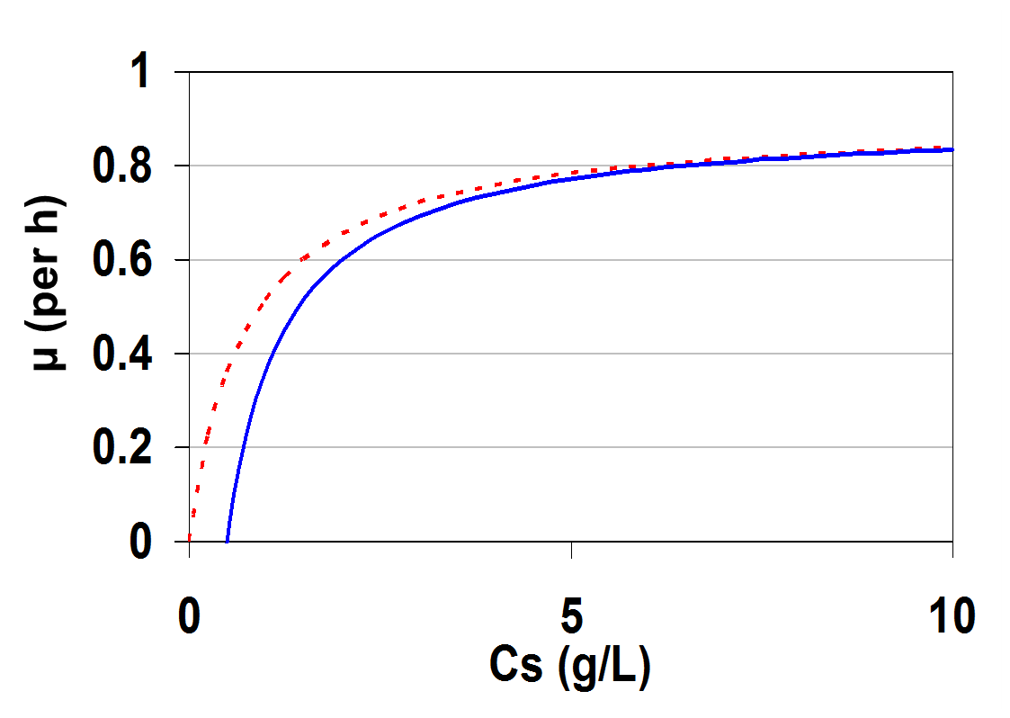
Extended Monod model:
μ_{m} (C_{S} – C_{S,min})
Extended Monod model includes a C_{S,min} term, which denotes the minimal substrate concentration needed for cell growth.
μ =
K_{S} + C_{S} – C_{S,min}
μ (per h)
μ_{m} = 0.9 per h
Ks = 0.7 g/L
C_{S,min} = 0.5 g/L

Slide 30
Monod model for two limiting substrates:
C_{S1}
C_{S2}
μ =
μ_{m}
K_{S1} + C_{S1}
K_{S2} + C_{S2}

Slide 31
Monod model modified for rapidly-growing, dense cultures:
Monod model is not suitable for rapidly-growing, dense cultures.
The following models are best suited for such situations:
μ_{m} C_{S}
μ =
K_{S0} C_{S0} + C_{S}
μ_{m} C_{S}
μ =
K_{S1} + K_{S0} C_{S0} + C_{S}
where C_{S0} is the initial substrate concentration and K_{S0} is dimensionless.

Slide 32
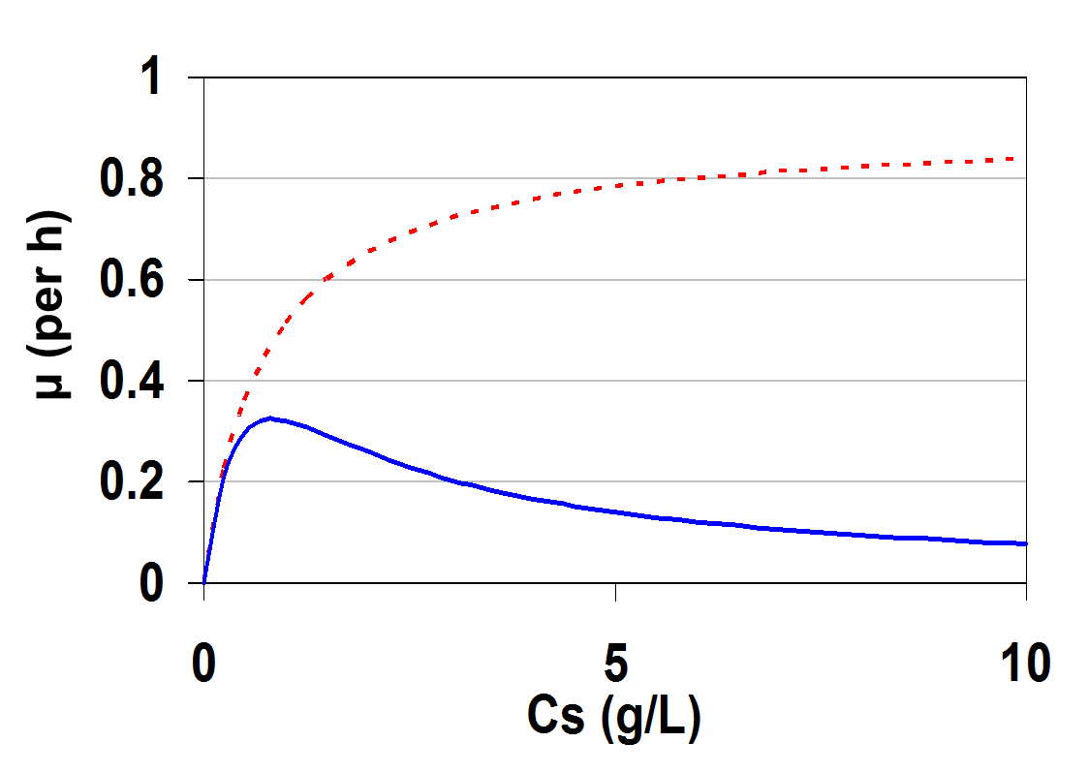
Monod model modified for substrate inhibition:
Monod model does not model substrate inhibition.
Substrate inhibition means increasing substrate concentration beyond certain value reduces the cell growth rate.
μ (per h)

Slide 33
Monod model modified for cell growth with noncompetitive substrate inhibition:
μ_{m}
μ =
(1 + K_{S}/C_{S})(1 + C_{S}/K_{I} )
μ_{m} C_{S}
=
K_{S} + C_{S} + C_{S}²/K_{I} + K_{S} C_{S}/K_{I}
μ_{m} C_{S}
If K_{I} >> K_{S} then
μ =
K_{S} + C_{S} + C_{S}²/K_{I}
where K_{I} is the substrate inhibition constant.

Slide 34
Monod model modified for cell growth with competitive substrate inhibition:
μ_{m} C_{S}
μ =
K_{S}(1 + C_{S}/K_{I}) + C_{S}
where K_{I} is the substrate inhibition constant.

Slide 35
Monod model modified for cell growth with product inhibition:
Monod model does not model product inhibition (where increasing product concentration beyond certain value reduces the cell growth rate)
For competitive product inhibition:
μ_{m} C_{S}
μ =
K_{S}(1 + C_{p}/K_{p}) + C_{S}
For non-competitive product inhibition:
μ_{m}
μ =
(1 + K_{S}/C_{S})(1 + C_{p}/K_{p} )
where C_{p} is the product concentration and K_{p} is a product inhibition constant.

Slide 36
Monod model modified for cell growth with product inhibition:
Ethanol fermentation from glucose by yeasts is an example of non-competitive product inhibition. Ethanol is an inhibitor at concentrations above nearly 5% (v/v). Rate expressions specifically for ethanol inhibition are the following:
μ_{m} C_{S}
μ =
(1 + C_{p}/C_{pm})
(K_{S} + C_{S})
μ_{m} C_{S}
μ =
exp(-C_{p}/K_{p})
(K_{S} + C_{S})
where C_{pm} is the product concentration at which growth stops.

Slide 37
Monod model modified for cell growth with toxic compound inhibition:
For competitive toxic compound inhibition:
μ_{m} C_{S}
μ =
K_{S}(1 + C_{I}/K_{I}) + C_{S}
For non-competitive toxic compound inhibition:
μ_{m}
μ =
(1 + K_{S}/C_{S})(1 + C_{I}/K_{I} )
where C_{I} is the product concentration and K_{I} is a constant to be determined.

Slide 38
Monod model extended to include cell death kinetics:
μ_{m} C_{S}
μ =
- k_{d}
K_{S} + C_{S}
where k_{d} is the specific death rate (per time).

Slide 39
Limitations of unstructured non-segregated models:
No attempt to utilize or recognize knowledge about cellular metabolism and regulation
Show no lag phase
Give no insight to the variables that influence growth
Assume a black box
Assume dynamic response of a cell is dominated by an internal process with a time delay on the order of the response time
Most processes are assumed to be too fast or too slow to influence the observed response.

Slide 40
Product formation kinetics
Classified based on the relationship between product synthesis and energy generation in the cell
Growth associated
Non-growth associated
Mixed-growth associated

Slide 41
Products
Growth-associated
produced at the same time as cell growth
constitutive enzymes (ones that are normally present)
glucose isomerase
metabolic intermediates
pyruvate, citrate, acetate
Non-growth-associated
takes place during the stationary phase (m=0)
secondary metabolites
antibiotics
Mixed - growth associated
takes place during growth and stationary phases
metabolic byproducts
lactate, ethanol
secondary metabolites

Slide 42
Product generation
X,
P
X,
P
X,
P
Time
Time
Time
Growth-associated
Mixed-growth
associated
Non-growth
associated

Slide 43
Product Formation
Growth-associated products - produced simultaneously to growth (exponential, decline)
Constitutive Expressed Enzyme
Substrate Utilization enzymes
Non growth associated - takes place during stationary phase
q_{p}= constant
Antibiotics
RDX degradation

Slide 44
Product Formation - cont
Mixed-growth-associated
Luedeking-Piret Equation
α = 0 non-growth associated
β = 0 only growth associated
α = Y_{P/X}
Examples
Lactic acid fermentation
Xanthan gum production

Slide 45
Microbial Growth
Maintenance Coefficient
1 mole of ATP generated during catabolism allows
• theoretically → synthesis of 32 g cells
• in praxis → 10.5 g cells
The maintenance coefficient (ms) is the reason for
2/3 being “wasted”
Substrate transport into cell (e.g. against diffusion gradient)
Osmotic work
Motility
Intracellular pH
Replacement of thermally denatured proteins (↑ T → ↑ ms)
Leakage of H+ ions across membrane (uncoupling)
ms influences Y, μ and the metabolic activity of the cells and
is thus important to be considered in bioprocesses.
S (mg)
ms =
X (mg) • time (h)

Slide 46
Effect of Maintenance Coefficient on Growth Rate
What is maintenance coefficient?
The energy supply rate needed to maintain the life functions of a non growing cell.
Units?
strictly speaking: mol ATP/ cell/ h
mostly used: g substrate / g biomass / h = (h-1)

Slide 47
Effect of Maintenance Coefficient on Growth Rate
What does the maintenance coefficient (mS) affect?
ms is the reason for Y not being constant.
ms → ↓ Y hence
ms → ↓ u
Why? Because some substrate is taken up just for maintenance, not for growth.
Effect is more apparent in slow growing cultures than in fast growing cultures.
Slow growing cultures can have a very low Y .
mS (gS/gX/h) * Ymax (gX/gS) = Decay rate (h-1)

Slide 48
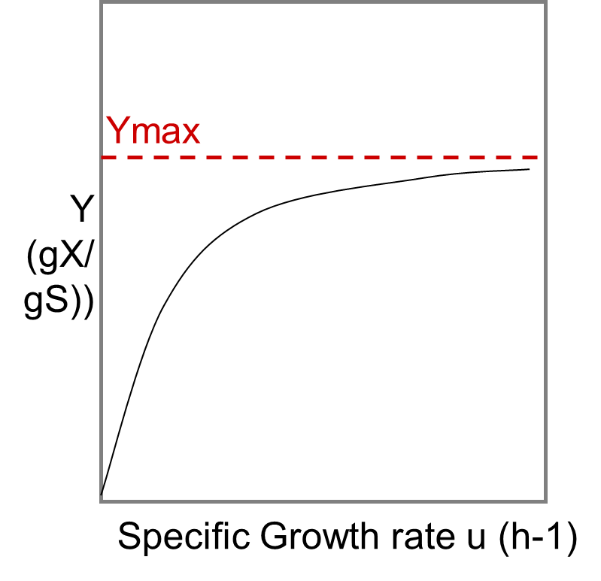
Effect of maintenance coefficient on growth rate
Effect of mS on Y?
Y is the observed yield coefficient.
The maximum yield coefficient Ymax is approached only when μ = μmax
Ymax is one of four growth constants

Slide 49
Effect of maintenance coefficient on growth rate
mS and Ymax can be combined:
mS (gS/gX/h) * Ymax (gX/gS) = Decay rate (h-1)
The Pirt equation of growth includes all four growth constants:
S
µ = µ_{max} * -------- - m_{S} *Y_{max}
S + k_{S}

Slide 50
Effect of maintenance coefficient on growth rate
ms the respiration activity used to just stay alive
u = (v – m_{S}) *Y_{max}
S
u = ( v_{max} * -------- - m_{S}) * Y_{max}
S + k_{S}
S
µ = Y_{max} * v_{max} * -------- - m_{S} *Y_{max}
S + k_{S}
S
µ = µ_{max} * -------- - m_{S} *Y_{max}
S + k_{S}
substrate uptake

Slide 51
Effect of Maintenance Coefficient (mS) on growth Rate
ignoring mS
S
µ
(h-1)
µ = µ_{max} * ----------
S +
k_{S}
0
including mS
S(g/L)
S
µ = µ_{max} * -------- - m_{S} *Y_{max}
S + k_{S}

Slide 52
Effect of Maintenance Coefficient (mS) on growth Rate
Sm = critical substrate concentration → growth is zero
µ
(h-1)
mS.kS.Ymax
sm= ------------------
umax- ms.Ymax
0
S(g/L)
Sm

Slide 53
Effect of Maintenance Coefficient (mS) on growth Rate
The negative specific growth rate (µ) observed in the absence of substrate
(when S = 0)
(cells are starving, causing
loss of biomass over time)
is the decay rate m_{S}*Y_{max}
µ
(h-1)
0
S(g/L)
- mS*Ymax

Slide 54
Light Illumination Effect
Oscillatoria agardhi Gomont
(Post AF, R de Witt, LC Mur, J. Plank. Res., 7 (1985) 487-495)
[Chl a/X]
μ
288K
293K
290K
0.010
293K
0.2/h
283K
288K
I
283K
20W/m
2
I
20W/m
2

Slide 55
Temperature effect
Modified Arhenius Model
μ
Arhenius Approximation
Microbial growth
1/T

Slide 56
Temperature Effect Classification of Microorganism
Thermophiles
μ
Mesophiles
Psychrophiles
Obligate
Facultative
T
273
293
313

Slide 57
Questions?

